Slide 1
Cytoscape : The De-facto Standard Tool For Biological Networks Visualization
Shanzida Jahan Siddique
Bfix 548
12/10/2018

Slide 2
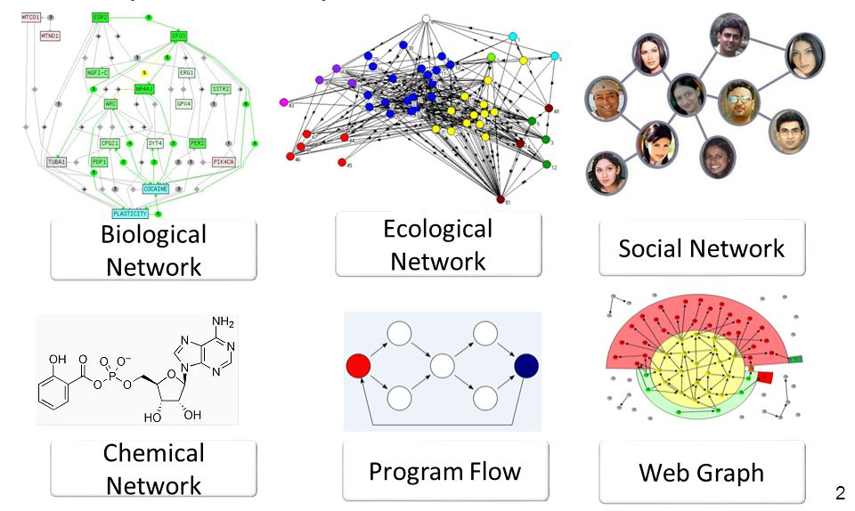
Networks Are Everywhere

Slide 3
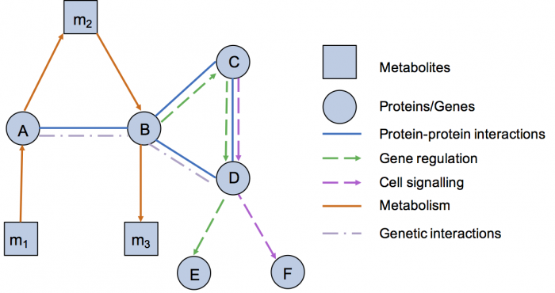
Areas of Biological Networks
Protein–protein interaction networks.
Gene regulatory networks
Gene co-expression networks
Metabolic networks
Signaling networks

Slide 4
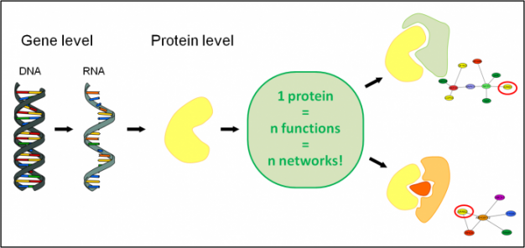
Importance of investigating Biological Networks
Gene function prediction
Detection of protein complexes/subnetworks
Identification of disease subnetworks
Subnetwork based diagnosis

Slide 5

An open source platform for Biological Network data Integration, Analysis and Visualization.
Developed and maintained by universities , companies and research institutions.
De-facto standard software in biological research community
Expandable by Apps

Slide 6
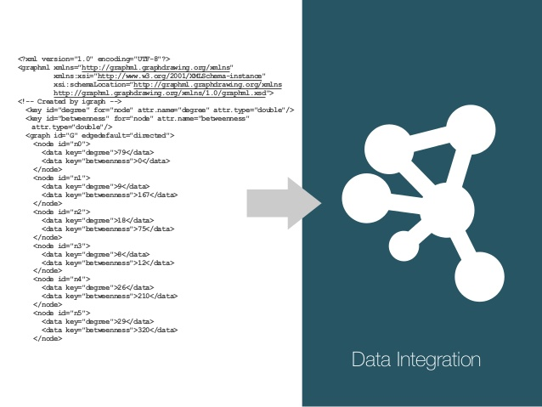
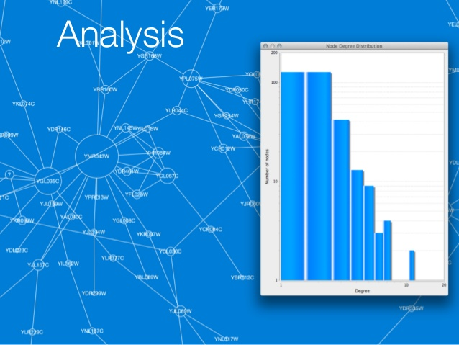
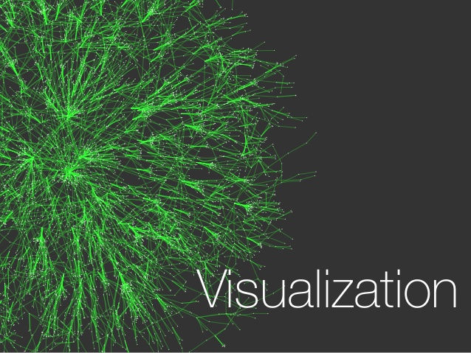
Three Basic Steps for Data Visualization with Cytoscape
Data Integration
Analysis/Mapping
Visualization

Slide 7
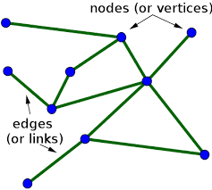
Data Analysis/Mapping in Cytoscape
Cytoscape deals with nodes and edges.
Each node can have its own attributes such as gene symbols, expression level etc.
Each edge can have its own attributes such as type of interaction, its strength etc.
Cytoscape integrates these informations on to a network.

Slide 8
Analysis of Tryptophan A (TrpA) protein-protein interaction Network from E.coli

Slide 9
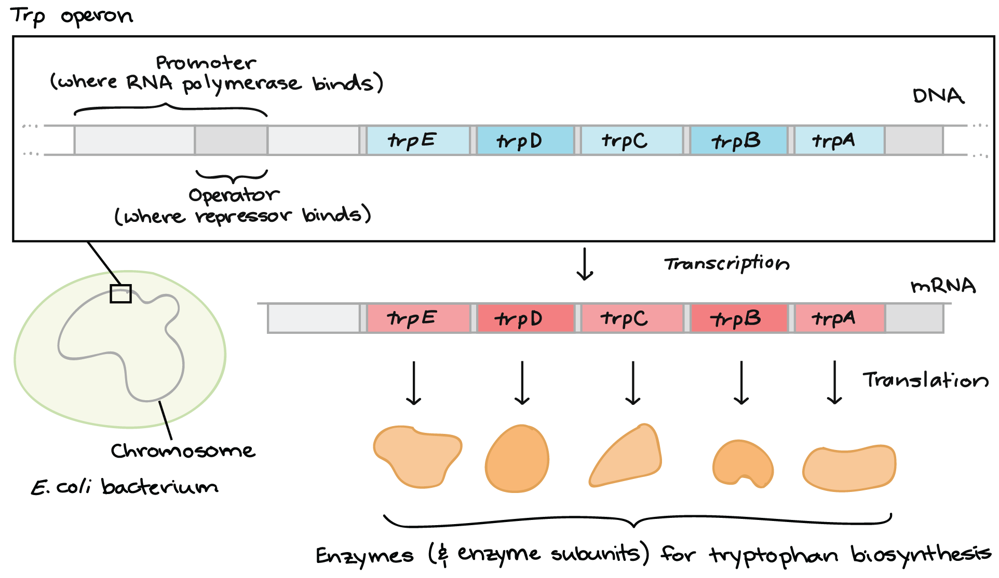
Tryptophan Operon has Five Genes

Slide 10
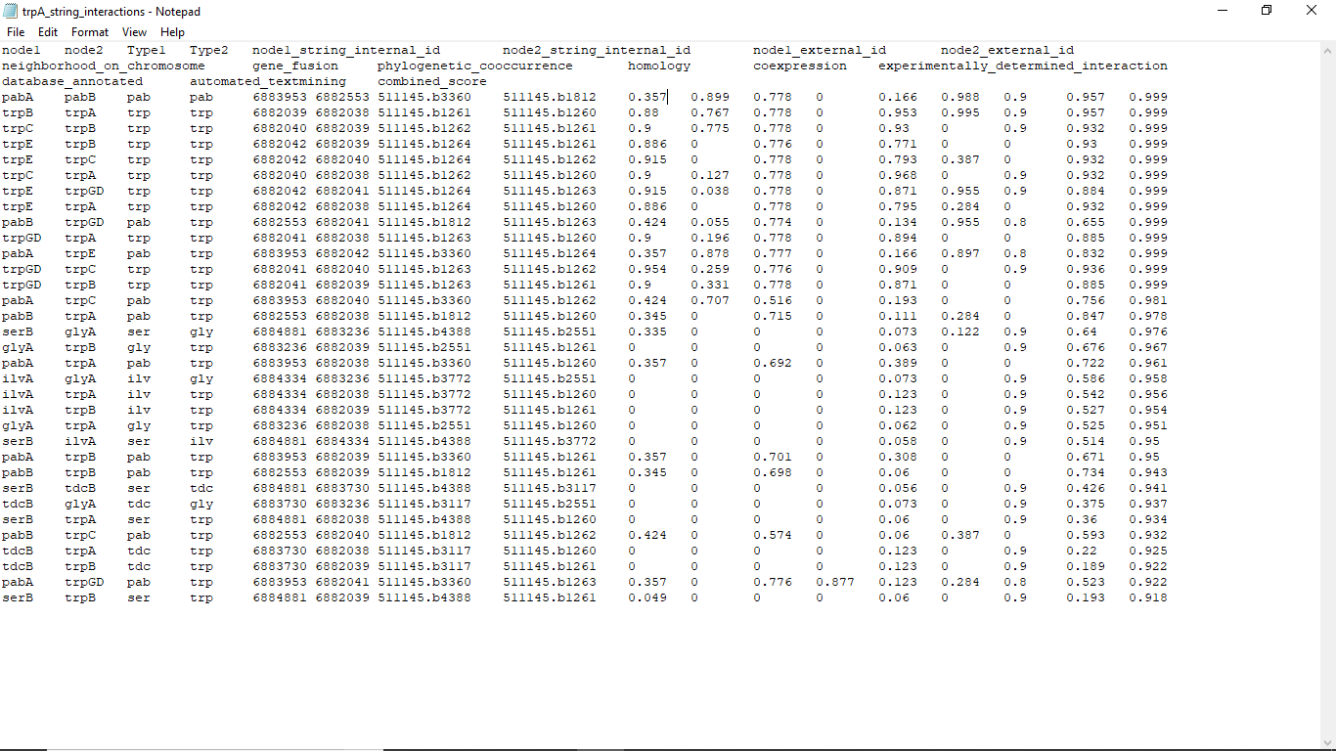
TrpA Interaction Network Data set
A small E. coli protein-protein interaction network obtained from the STRING database
A small network of proteins that interact with trpA.

Slide 11
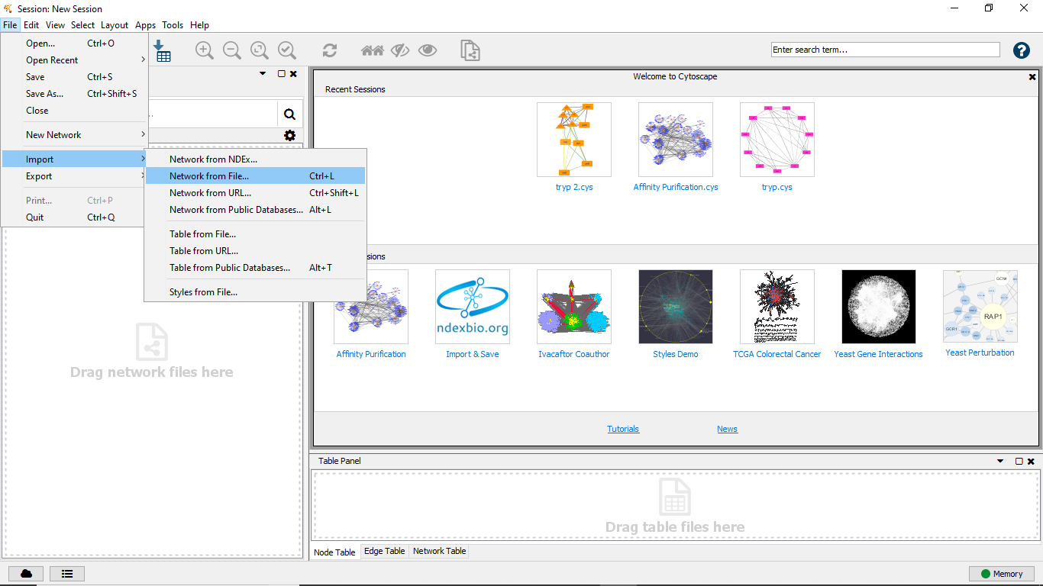
Data Integration into Cytoscape
The tabular data was in ASCII format with column separated by the “tab” character.

Slide 12
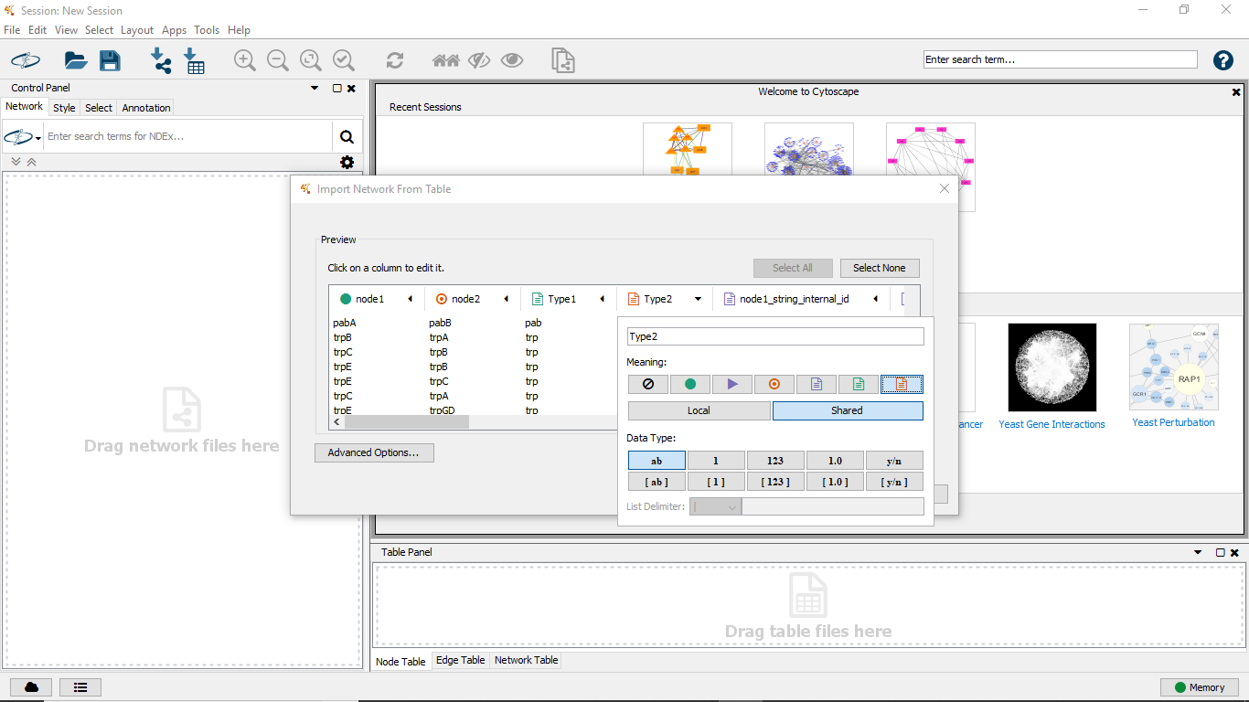
Analysis/Mapping
Here I manipulated nodes and edges

Slide 13
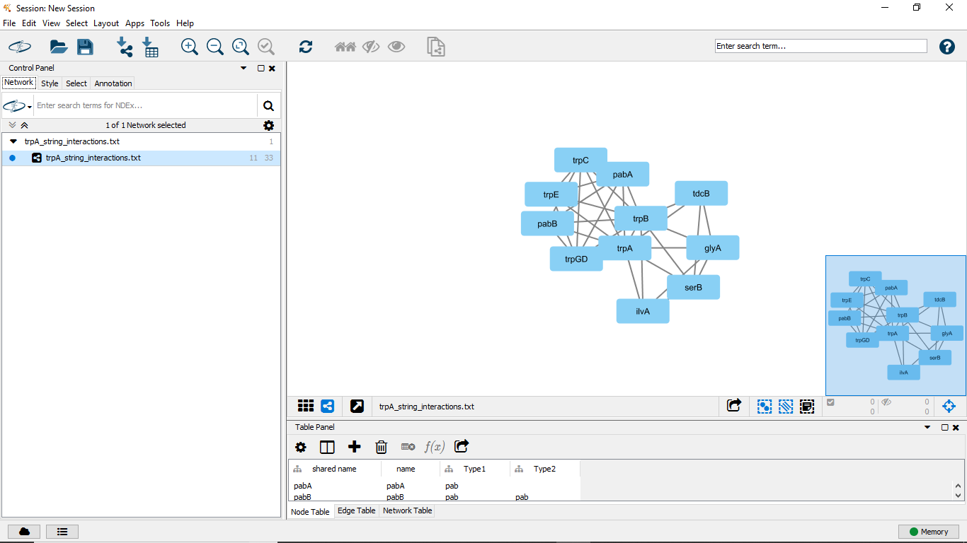
Initial Network Visualization

Slide 14
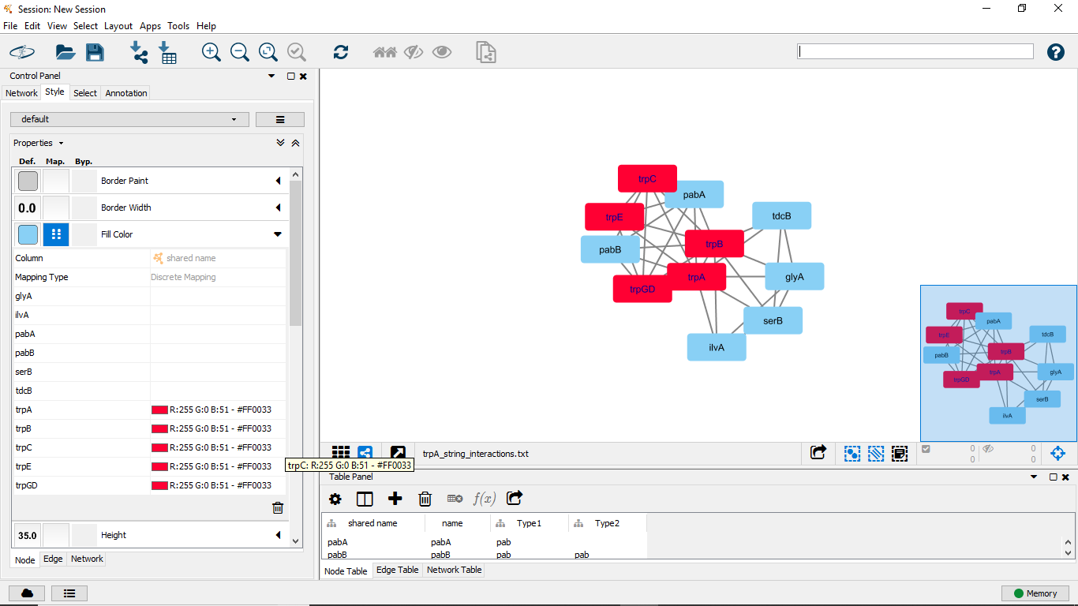
Specific Visualization: Nodes

Slide 15
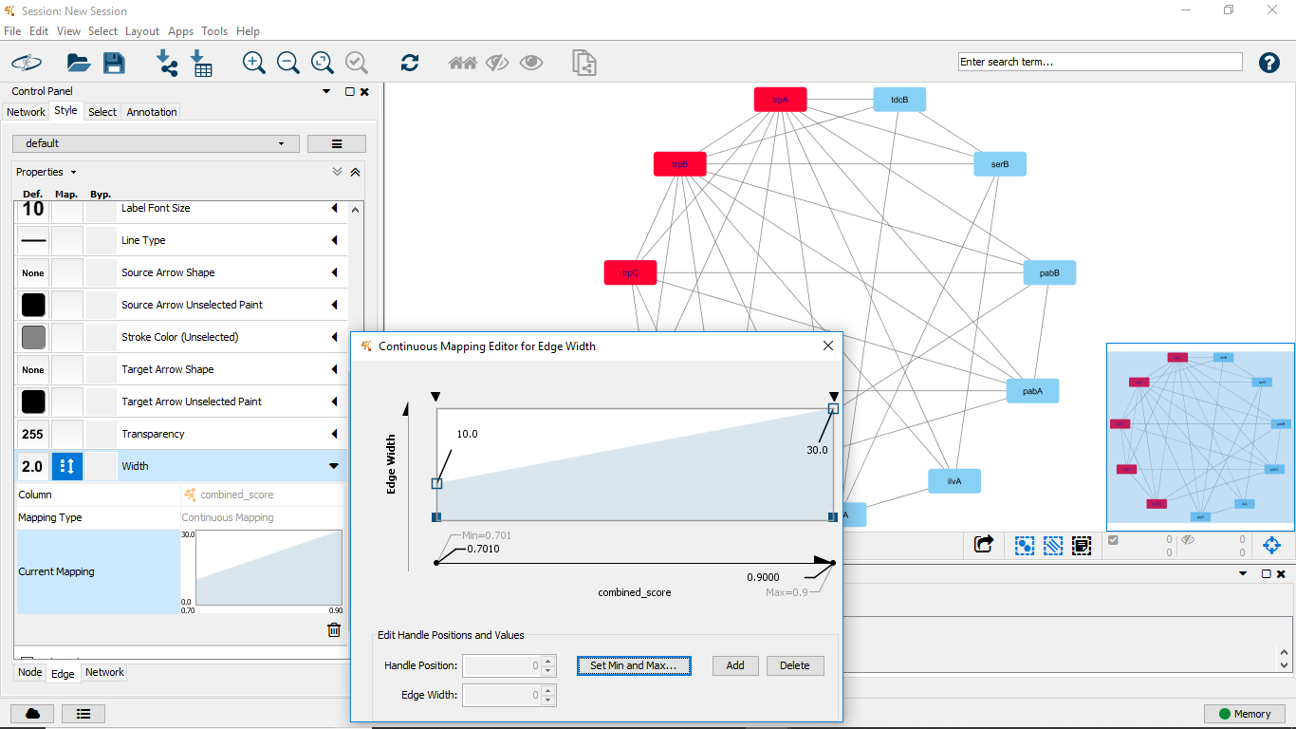
Specific Visualization: Edges

Slide 16
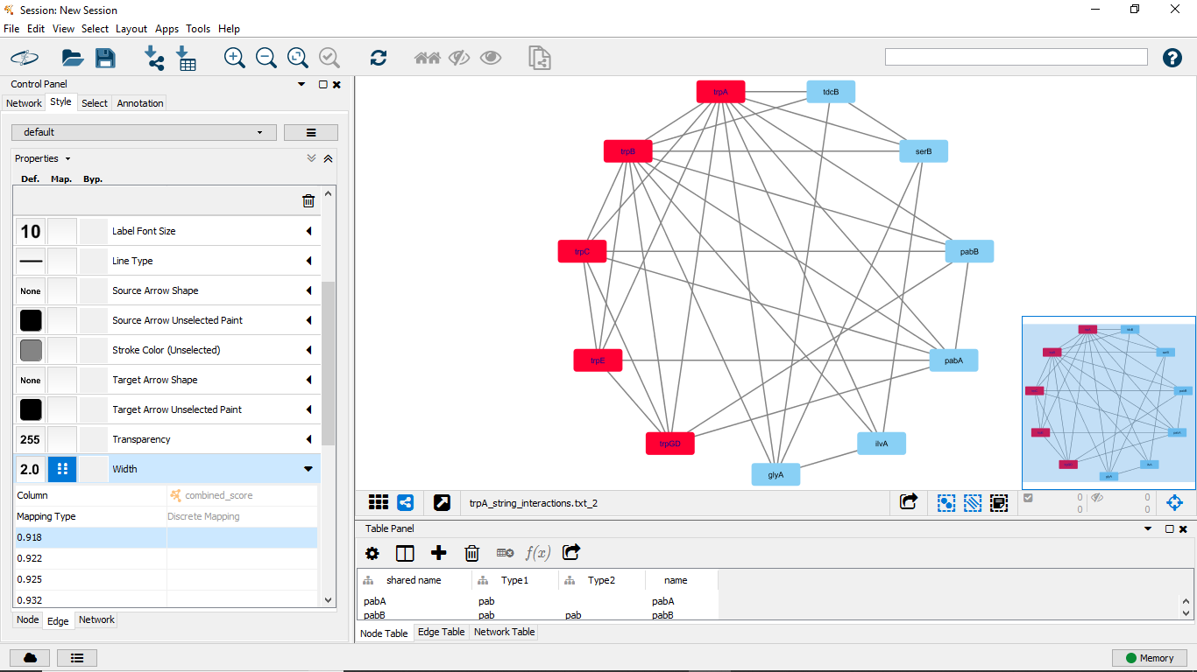
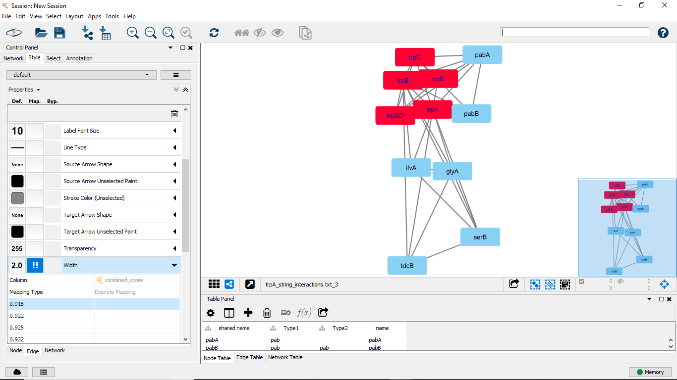
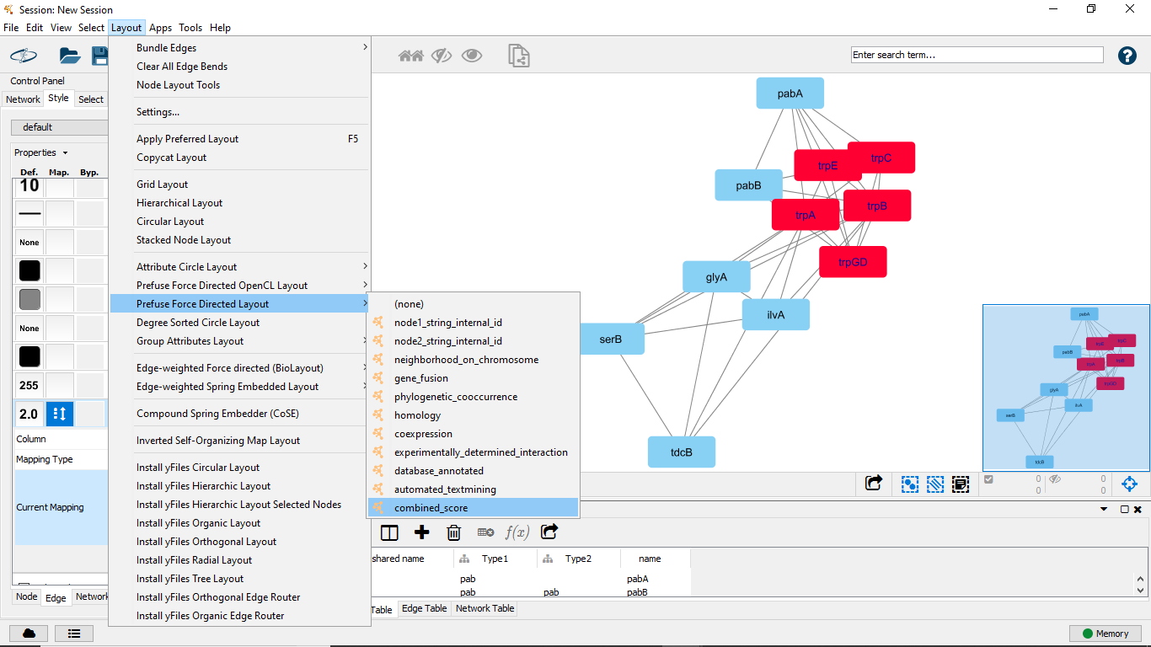
Different Visualization Layouts
Attribute Circle Network
Perfuse Force directed open CL layout
Perfuse Force Directed Layout

Slide 17
Summary
Investigation of Biological networks are very important for understanding biological function
Data Analysis and visualization is an important part of network analysis
Ctyoscape is the most important network visualization tool up to date.

Slide 18
Thanks

